Slide 1
Helping You Build the Foundation to Choose Your
Medicare Insurance Plan

Slide 2
PRESENTED BY | Lawley
Ranked Nationally
400+ Specialized Employees
Trusted Carrier
Relationships
Claims & Risk Management

Slide 3
Medicare Components

Slide 4
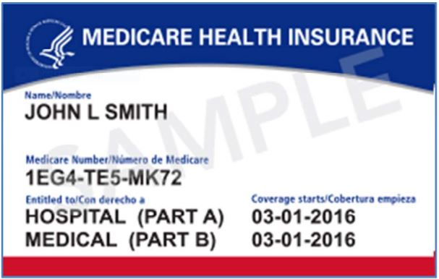
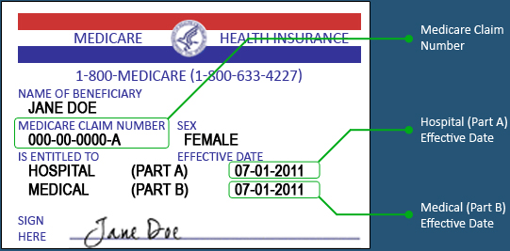
Original Medicare
Medicare Claim Number
Hospital (Part A) Effective Date
Medical (Part B) Effective Date

Slide 5
PART A | Hospital
Inpatient hospital care
Inpatient mental health care
Skilled nursing services – 20 days
Hospice care
Some blood for transfusions

Slide 6
PART B | Doctor & Outpatient Visits
Physician services
Outpatient hospital services
Ambulance
Outpatient mental health
Laboratory services
Durable medical equipment (wheelchairs, oxygen, etc.)
Outpatient physical, occupational and speech language therapy
Some preventative care

Slide 7
What’s Not Covered
Medicare Part A and Part B deductibles
Prescription drug coverage
Additional items such as hearing and dental

Slide 8
Do I Need More Coverage?
Medicare
Advantage
Medicare
Supplement
“PART C”
“Medigap”

Slide 9
Comparison
Medicare
Advantage
Medicare
Supplement

Slide 10
What Fits My Situation?
IT DEPENDS
Medicare
Advantage
Medicare
Supplement
Lower Premium
Networks
Co-Pay for Hospital Stay
20 days Skilled Nursing
Higher Premiums
No Networks
100% Hospital Coverage
100 days Skilled Nursing

Slide 11
PART D | Prescription Drugs
Only offered through private insurance
Must continue to pay Part B premium

Slide 12
PART D | Fast Facts
COSTS
Prescription drug coverage varies from plan to plan
Catastrophic coverage protects you from very high drug costs
Benefits can change each year
ENROLLMENT
Coverage is not automatic – you must choose & enroll
Penalties may apply if you enroll late
COVERAGE
Each plan has a list of drugs that it covers (formulary)
Make sure your drugs are covered before you enroll in a plan
The list of drugs can change each year

Slide 13
PART D | Fast Facts
Formulary: List of drugs that the insurance plan covers
Many drug plans have a tiered formulary. That means the plan divides drugs into groups called “tiers”. Generally, the lower the tier, the lower your copay.
Tiered Formulary
Tier 5 $$$$$
Tier 4 $$$$
Tier 3 $$$
Tier 2 $$
Tier 1 $

Slide 14
PART D | Four Phases
Deductible
Initial Coverage
Coverage Gap “Donut Hole”
Catastrophic

Slide 15
EPIC| Elderly Pharmaceutical Insurance Coverage Plan
Annual income for eligibility is up to $75,000 for singles and $100,000 for married couples.
Members must be enrolled in a Medicare Part D drug plan to receive EPIC benefits.
Provides secondary coverage for Medicare Part D and EPIC covered drugs purchased after the Part D deductible, if any, is met.
Covers many Part D excluded drugs.
EPIC co–payments continue to be $3, $7, $15 or $20 based on the cost of the drug.
Provides Medicare Part D drug plan premium assistance for many members.
2019 Program Highlights

Slide 16
What is a Prior Authorization (PA) for Prescription Drugs?
When an insurance carrier requires your doctor to complete a form authorizing why medically you need to be taking a certain drug.
The insurance carrier will need to receive the prior authorization form and approve the authorization before the prescription can be filled.
If you do not get the approval first, the insurance carrier may not cover the prescription drug.
Please check the insurance carrier’s drug formulary list to confirm if your drug needs a PA.
Also, if you move insurance carriers, you may need to complete a new PA for a drug you have been taking to ensure you can continue to have that drug covered under your new insurance carrier.

Slide 17
What is the Monthly Claims Report from MVP or the Explanation of Benefits (EOB) from Excellus?
A summary of your medical and hospital claims provided on a monthly basis for which you received care and a claim was processed under your plan.
It will show in detail:
Medical care you received
What was paid by the insurance carrier
How much you paid out-of-pocket or can be expected to be billed by the provider if you did not pay at time of service
Review these in detail and if there are any discrepancies or questions, call your insurance carrier.

Slide 18
What if a Medical or Pharmacy Claim is Denied?
Reach out to your insurance carrier first to understand the denial decision and receive an initial determination of the denial.
Reach out to your provider to see if the claim may have been coded incorrectly or insufficient information was sent to the insurance carrier.
If the claim is still denied and you do not agree with the denial, have your provider request a peer-to-peer review with the insurance carrier.
If the claim continues to be denied, you can file an appeal with your insurance carrier. Appeals must be filed within 60 days from the date of the written notice of denial. Please reach out to your insurance carrier for the steps and timeline for the formal appeals process.

Slide 19
Your Benefits Consultant for Individual & Senior Health Insurance
Anthony (AJ) Dolce
(o)716.673.6235
(c)716.485.1574
adolce@lawleyinsurance.com
3988 Vineyard Drive
Dunkirk, NY 14048

